Slide 1

Hidden Secrets: Steganography & Cryptography for CTFs
Jordan, Rich, and Yang
For Pecan+ 2025
16^{th August 2025}
Notes:
Welcome everyone
Introduce self and helpers
Ask if they’ve ever hidden a message from someone or wanted to.
Explain that after today, theyre going to understand just a bit more about how to hide messages, and how to stop people from reading messages

Slide 2
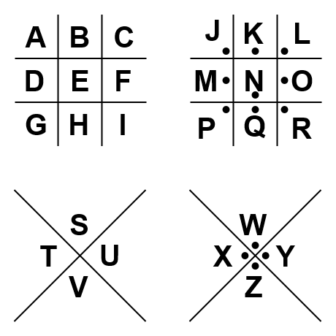

What is: Cryptography
A | B | C | D | E | F | G | H | I | J | K | L | M | N | O | P | Q | R | S | T | U | V | W | X | Y | Z
D | E | F | G | H | I | J | K | L | M | N | O | P | Q | R | S | T | U | V | W | X | Y | Z | A | B | C
Khoor Shfdq
=
=
Hello Pecan
Notes:
Cryptography is making information unreadable to protect it
There are two methods of encryption here, the first is called a pig pen cipher, the other is called a ceaser shift or a rotation cipher. In this case the shift is 3.
These both have the same message, but without the keys, we wouldn’t be able to decode them.
Take a second and try to decode these.
Ultimately, Cryptography is locking a message into a box, so that only people with the right key can get into it.

Slide 3
What is: Cryptography
Cryptography locks messages
Only people with the key can read them
BUT
Everyone can see the message even if they can’t understand it
Notes:
Cryptography is making information unreadable to protect it
There are two methods of encryption here, the first is called a pig pen cipher, the other is called a ceaser shift or a rotation cipher. In this case the shift is 3.
These both have the same message, but without the keys, we wouldn’t be able to decode them.
Take a second and try to decode these.
Ultimately, Cryptography is locking a message into a box, so that only people with the right key can get into it.

Slide 4
Cryptography: Common Ciphers
Rotation Ciphers, such as ROT13 and Ceaser Shift
Substitution Ciphers
Base64, 32, etc.
AES, RSA
Notes:
Explain that rotation ciphers are one of the ciphers we used in the first slide
Explain that substitution ciphers replace letters with other characters, and not necessarily in a programmatic way like the rotation ciphers, an example is the pig pen cipher we used in the first slide as the substitution doesn’t have to use normal letters.
Base64 is a common encryption method that will be seen in CTFs because its somewhat easy to decode. It works by converting letters from our limited alphabet of 26 characters, into a new alphabet that has a different amount of characters, and usually include symbols.
Finally, touch on RSA and AES, the modern gold standards of encryption. They use some very complex maths to hide messages, usually passwords and other personal data, in a way that’s retrievable. Often things like passwords go through a process called hashing, which is a type of cryptography, which makes the message unrecoverable from the ciphertext, this is useful for passwords because we don’t care what it is, only that an entered password is the same as the stored password.
But this is much more in depth than we’re going to go today.

Slide 5
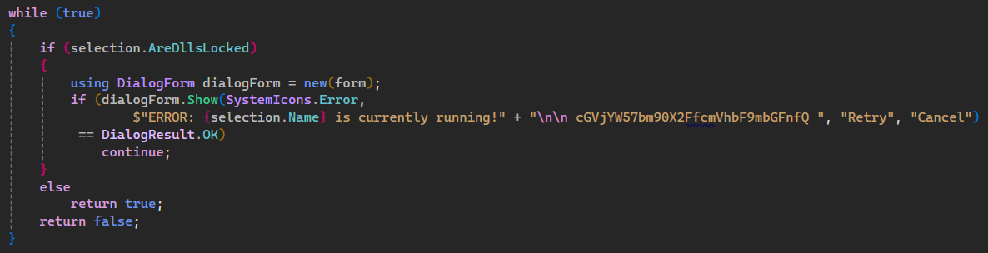
Cryptography: Common CTF Methods
Notes:
In a CTF you may be asked to do a bit of code reverse engineering to find a flag.
Heres one example of how a flag might be hidden. It might be inline like this, or in a comment, or be more complex and decoded at runtime.

Slide 6
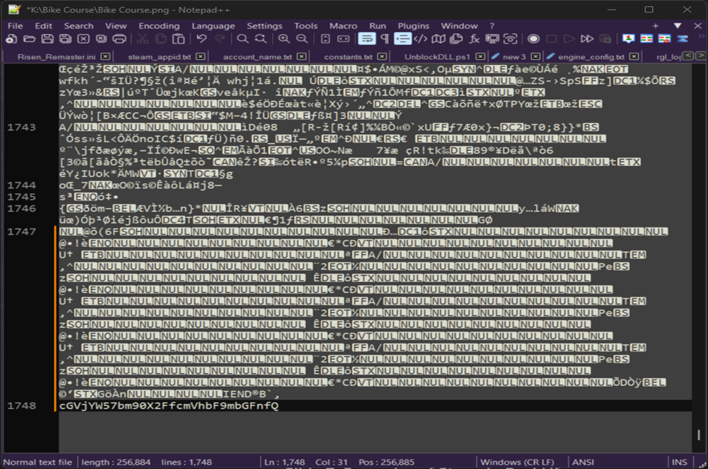
Cryptography: Common CTF Methods
Notes:
We’re still using base64 as an example here,
this is in an image file opened in notepad.
Theres space at the bottom of many files where it doesn’t affect the file if you change anything.
Flags are often hidden in the empty space in files.

Slide 7
Cryptography: Decryption
Decryption can take multiple steps
Step 1: Identify the Encryption method
Is it Base64 encoding? Rot13? Something else?
Step 2??
Date

Slide 8
Cryptography: Decryption
Step 2: Use a tool! Either online or otherwise
Cyberchef is a great online tool that can help, but you need to know what you’re looking at
Some ciphers can be done on paper easier than digitally
Sometimes using ChatGPT or other conversational models can help you break a problem down into parts that you better understand
Date

Slide 9
Insert Heading 1
Insert Heading 2
Date

Slide 10
What is: Steganography?

Slide 11
What is: Steganography
Doesn’t hide the meaning of the message
Hides the message itself
Often paired with Cryptography
Date
Notes:
Steganography, or stego, in contrast to encryption
Hides the message itself, it stops people from reading it at all, but if you know how to look, you can read the message too.

Slide 12
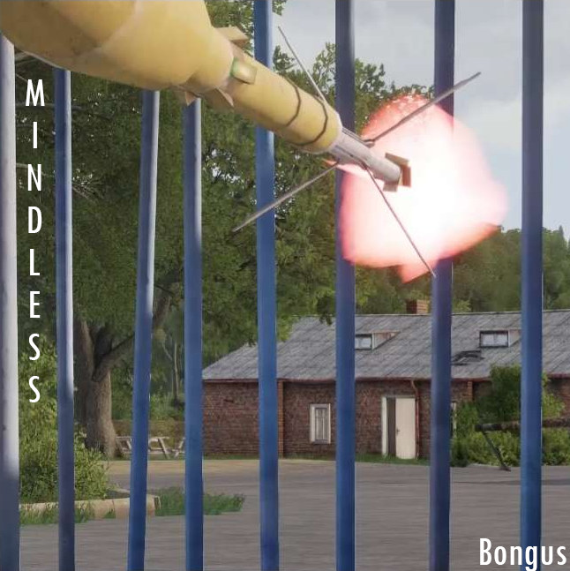
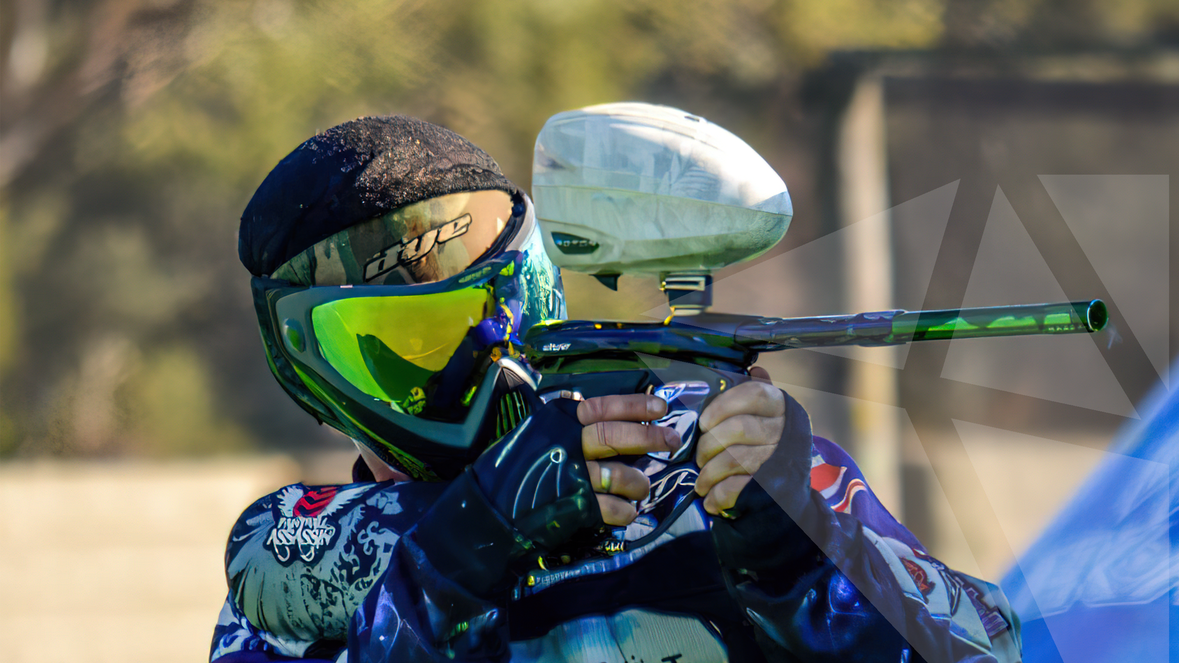
What is: Steganography
Date
Notes:
Both images could have other content hidden within them
And it could be anything.
The key with steganography is that you would never know there was more to these images than their regular pixel data

Slide 13
What is: Steganography
Retrieve data with tools
StegSeek
StegHide
StegSolve
Often password protected
RockYou.txt
github.com/danielmiessler/SecLists
Can hide more puzzles
Date
Notes:
How do we retrieve the hidden data in the image?
Again we use tools! Such as StegSeek, StegHide, zSteg, Binwalk, and strings.
But that all depends on what kind of file you’re working with.
StegSeek, Steghide and zsteg are aimed at coverfiles that are usually images, but there are other coverfiles out there.
A recent CTF that I competed in used a memory dump that had an image hidden within it that was retrieved using binwalk
Embeded files are often password protected, this helps hide the data within the cover file. Some good lists for cracking the passwords are rockyou.txt and the seclists repo on github.
Its worth remembering that most challenges will avoid you needing to brute force a password, but with how quick it is for a tool to loop through a password list, it’s worth a try.

Slide 14
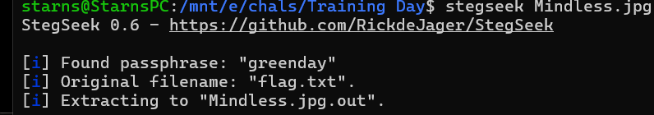
What is: Steganography
Notes:
Using that previous image as a coverfile, we have run it through a tool, in this case stegseek, and it’s cracked the password using the rockyou.txt wordlist.
Quite often embedded files will include the flag in an encrypted format, but sometimes they’re in plain text.

Slide 15
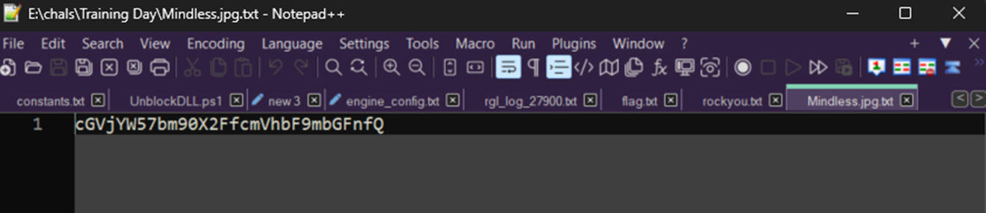
What is: Steganography
Notes:
In this case we’ve got our base64 encoded flag from earlier
When we’re talking about passwords, sometimes challenge creators will layer their challenges.
As an example, when we opened an image file earlier, there was a flag hidden at the end of the file.
When we go to crack a cover file, if the wordlist we have doesn’t work, its worth checking those basic hiding places
Sometimes there's a password, or a hint to a password in that empty space.

Slide 16
Tools & Resources
https://cryptohack.org/
https://pecanplus.ecusri.org/
https://gchq.github.io/CyberChef/
https://ctf.ecusri.org/
https://github.com/danielmiessler/SecLists
Work-Sheets
https://github.com/Rich042/PecanTrainingCryptoSteg

